Slide 1
Indy Wildlife Watch: Impact of Vegetation Structure on the Presence of Urban Wildlife
Cindy Cifuentes and Evynn Davis

Slide 2
Urbanization Increase
According to the UN Department of Economic and Social Affairs, population in urban areas will increase globally from 55% to 68% by 2050
80.7% of the U.S. population resided in cities in the 2010 US Census and forecasted to be at 87.4% by 2050 (UN DESA 2019)
The key to successful development is sustainable urbanization
For example: how can green spaces be managed in a way that is beneficial to wildlife while minimizing human-wildlife interactions
Notes:
Evynn

Slide 3
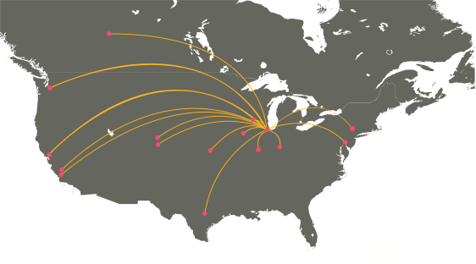
Indy Wildlife Watch
Urban Wildlife Information Network
Lincoln Park Zoo, Urban Wildlife Institute
Two 45km transects with 50+ sites
White River
Monon Trail
Assessing wildlife diversity and distribution
Effects of urbanization
Lincoln Park Zoo
Notes:
Cindy
Cities differ by transect number and length; urban to rural
All cities are collecting data in similar ways though: transects, 2km buffers spaced ~5km apart, cameras in varying habitats at least 1km from each other, same camera set up, etc.
Our research is part of a much larger project-

Slide 4
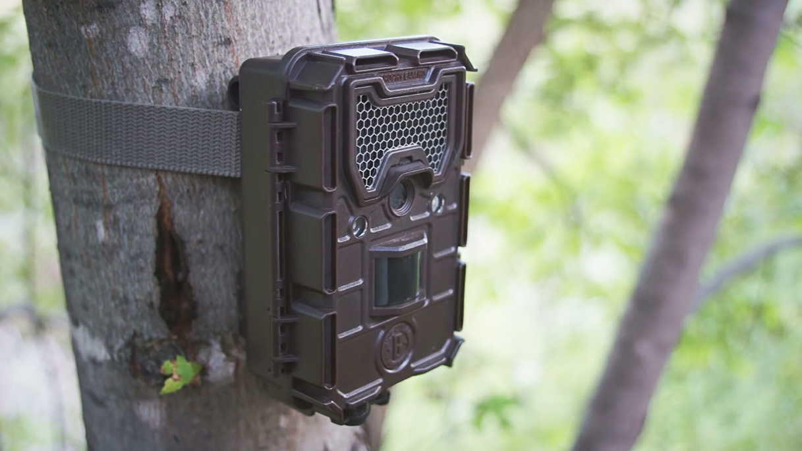
Camera methods
Motion sensor cameras
Fatty acid disk
Seasonally
Urban to Peri-urban
Trail Camera Deals
Notes:
Long term monitoring over multiple years to see time and city development changes; 4 months out of the year (Jan, April, July, Oct) but only OCT 17 today.
Cindy

Slide 5
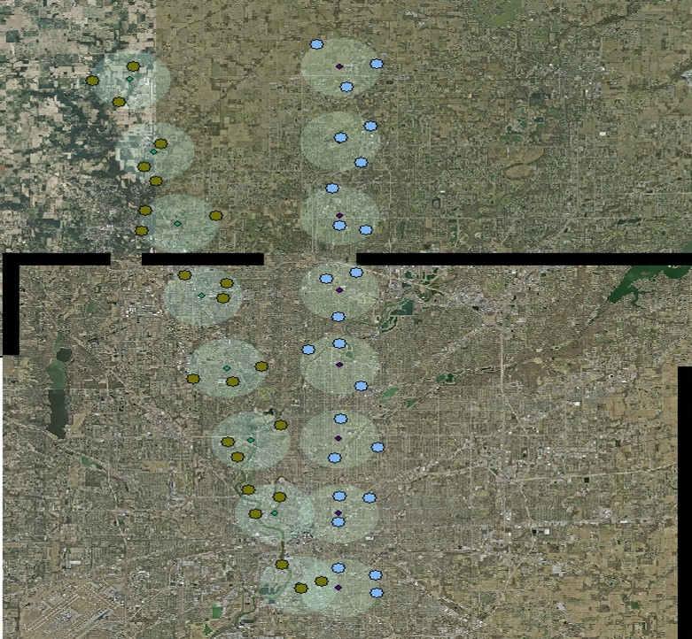
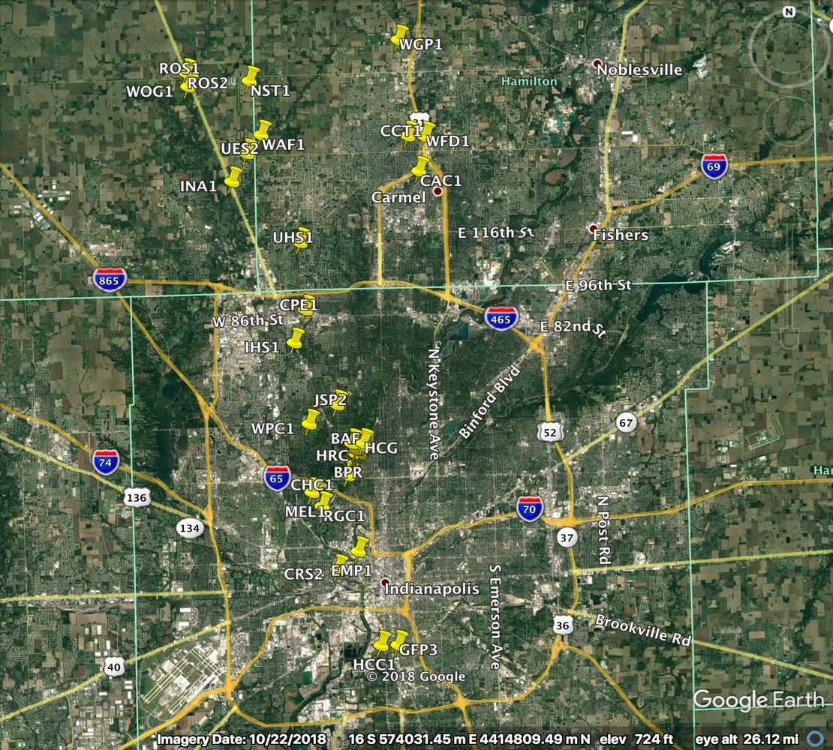
Notes:
Talk about subjective site names here
Cindy

Slide 6
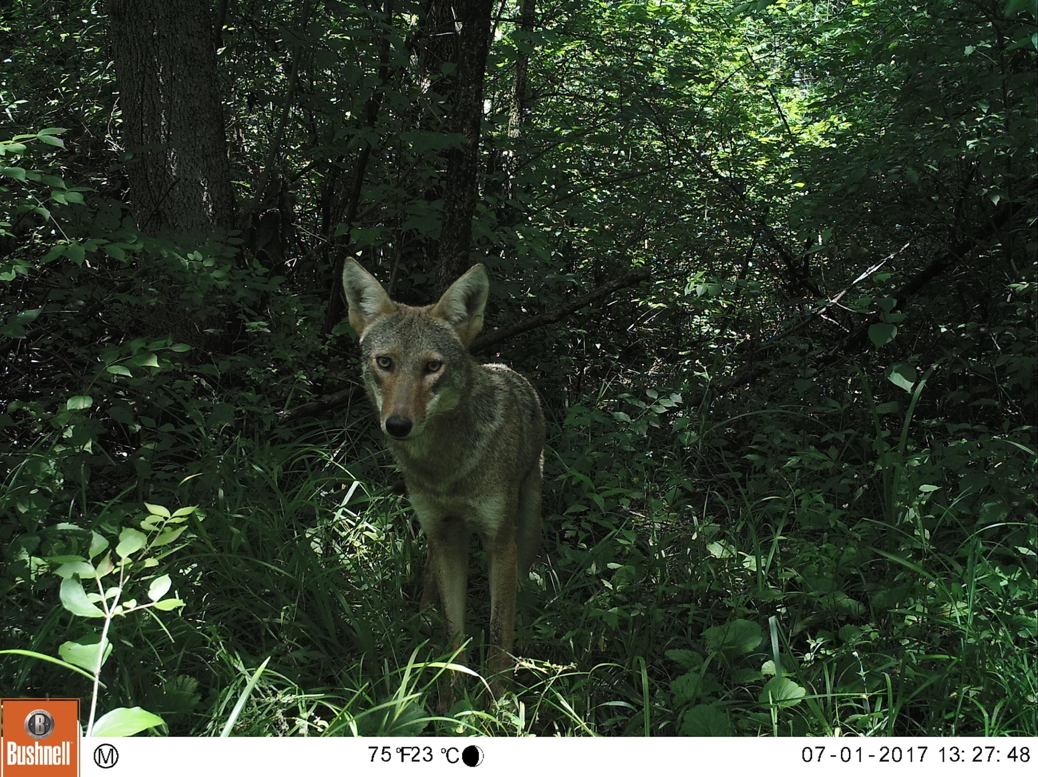
Notes:
Mention data, time, site, how we have data bc of these pictures

Slide 7
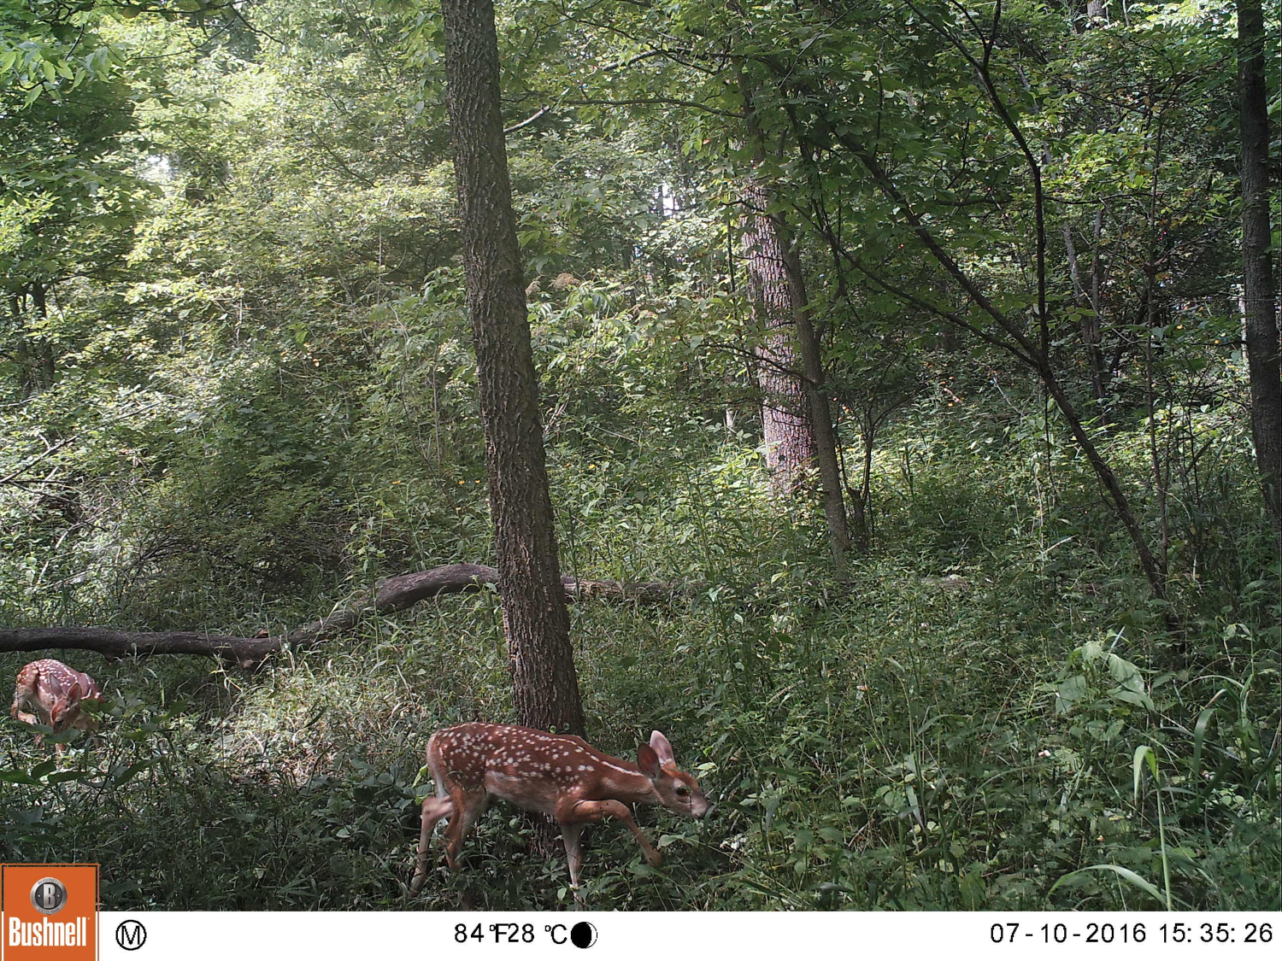

Slide 8
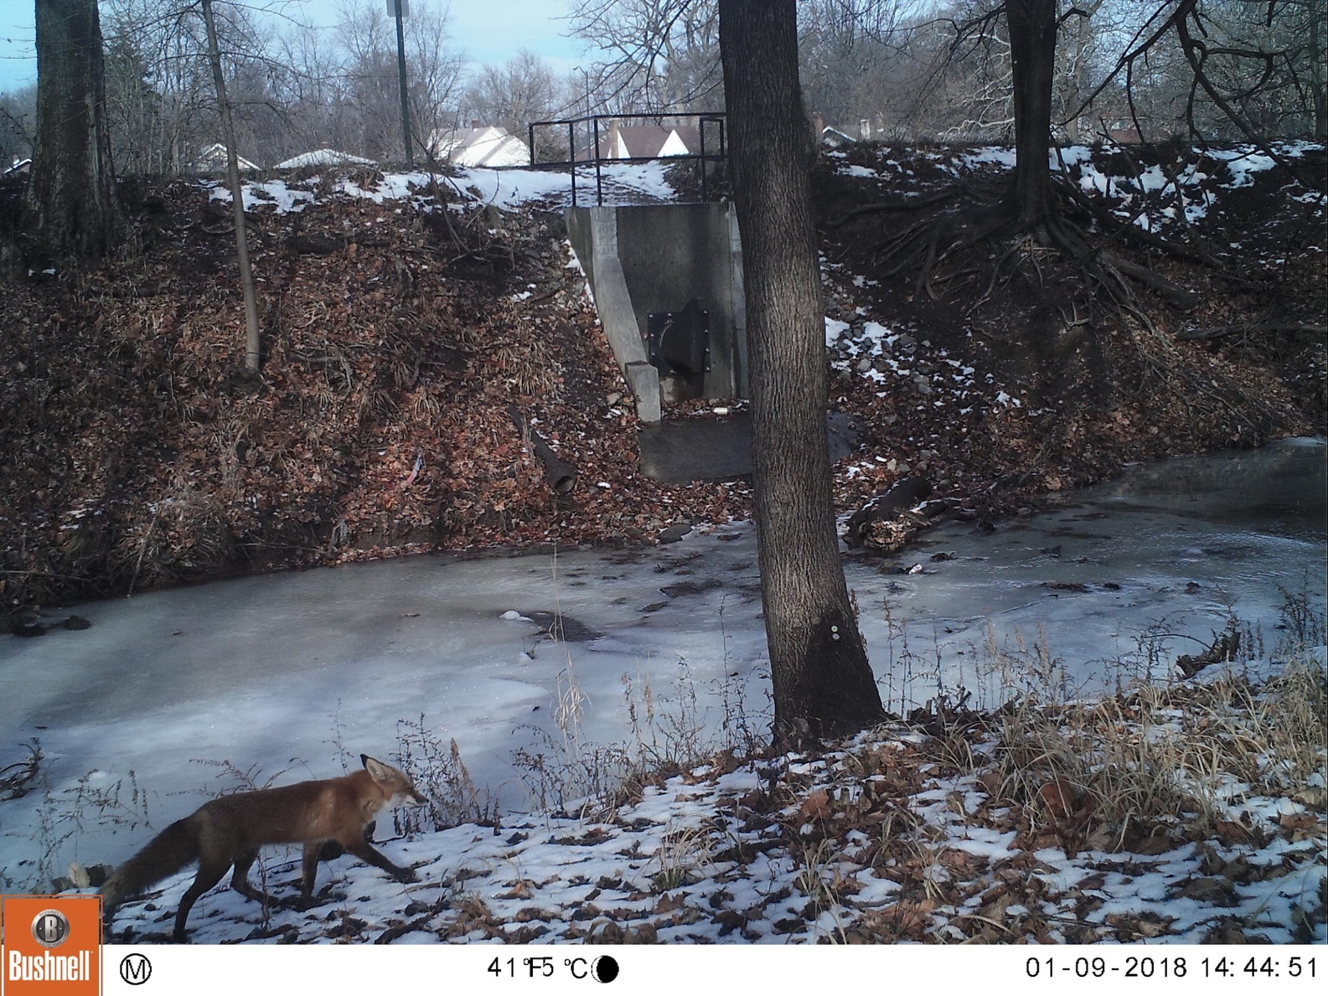

Slide 9
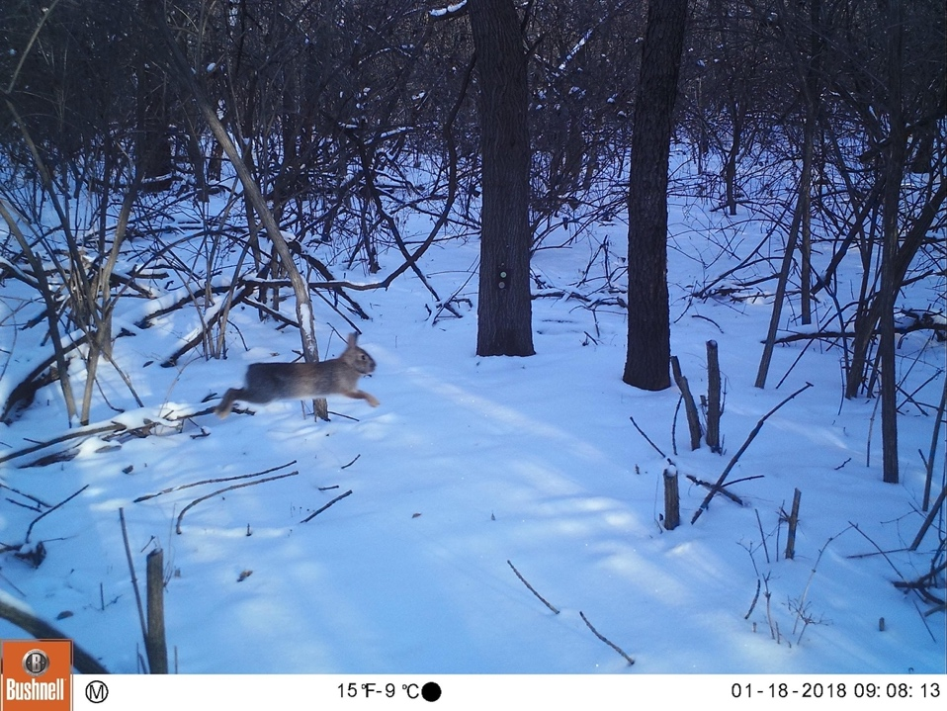
What drives wildlife occupancy?
Landscape Scale
Human population density
Habitat fragmentation
Fragment size
Impervious surfaces
Local Scale
Vegetation structure
Notes:
Evynn

Slide 10
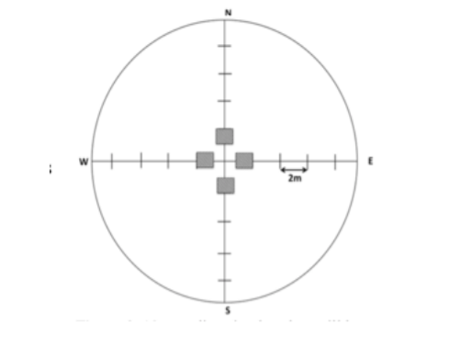
Methods
Vegetation sampled in October
Area that was most representative of overall vegetation structure
Two 20m perpendicular transects
Tree size: point center quarter method
Canopy cover: mirrored spherical densiometer
Shrub cover: line intercept
Understory herbaceous, grass, rocks, etc.: cover frequency plot
(Rogers et al. 2008)
Notes:
Evynn

Slide 11
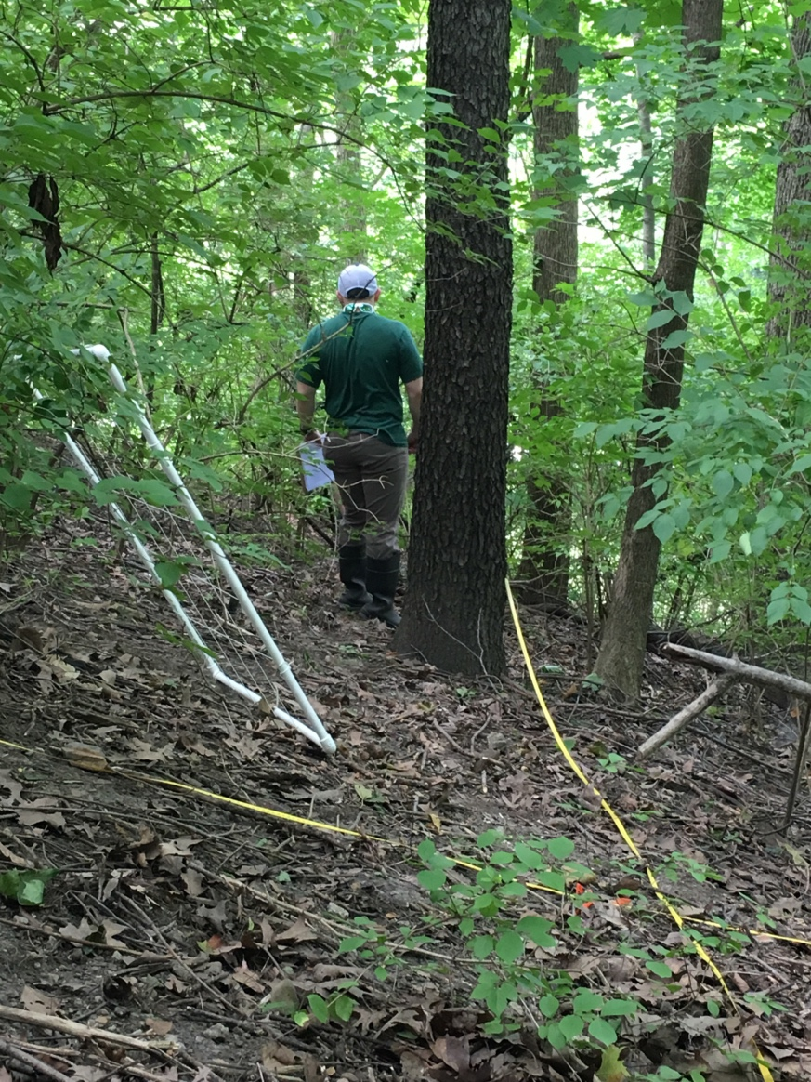
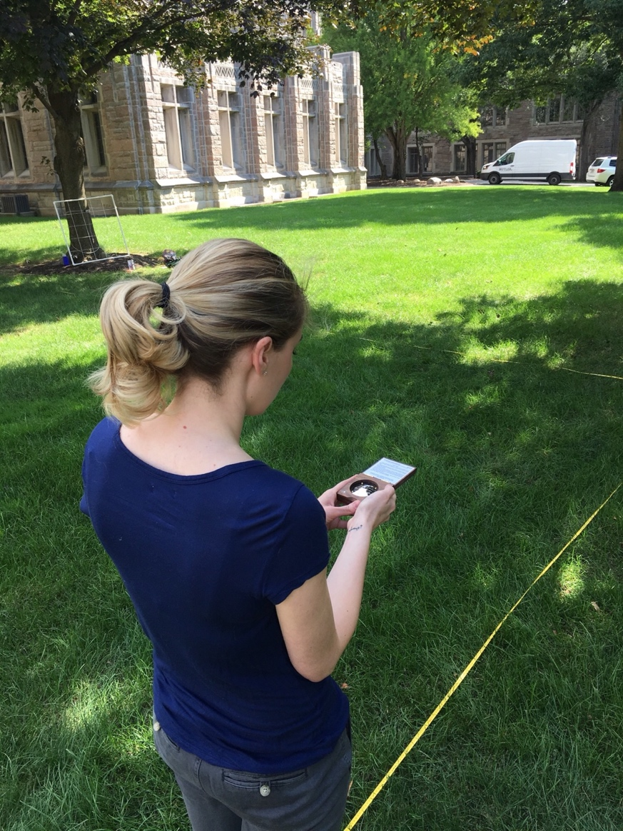
Notes:
Evynn

Slide 12
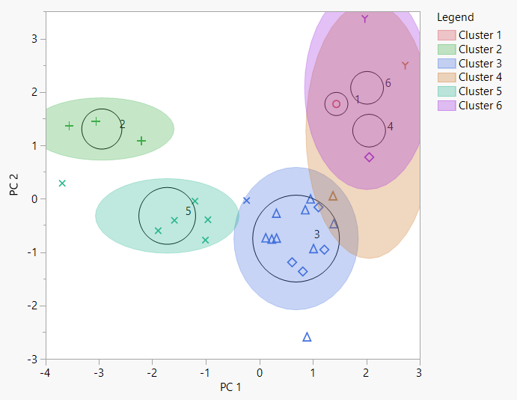
Notes:
Left- open areas with low complexity/ right- dense areas with high complexity
Cindy

Slide 13
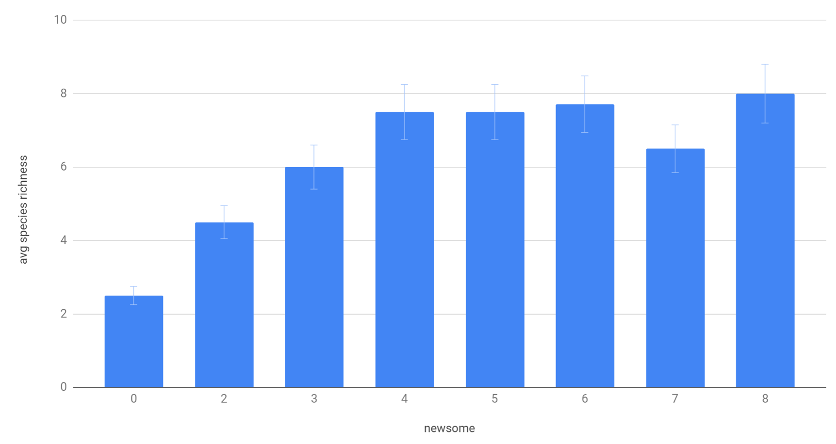
Results: Newsome Habitat Complexity
Shrub cover %
Canopy cover %
Ground herbage cover %
Debris- logs and rocks- cover %
Notes:
Evynn: Newsome HCS- 0-3 ranking on cover percentages of shrub, canopy, ground herbage, debris (logs & rocks)- max score of 12
Darker error bars

Slide 14
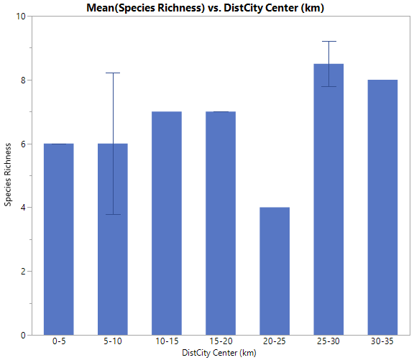
Results: Distance from city center
Notes:
Cindy
Its too complex, it could be due to variability between sites (butler versus other sites that are at the same sites). Distance may not be important to animals, its more complex than that. Also this is just prelimary data for just the month of Oct.

Slide 15
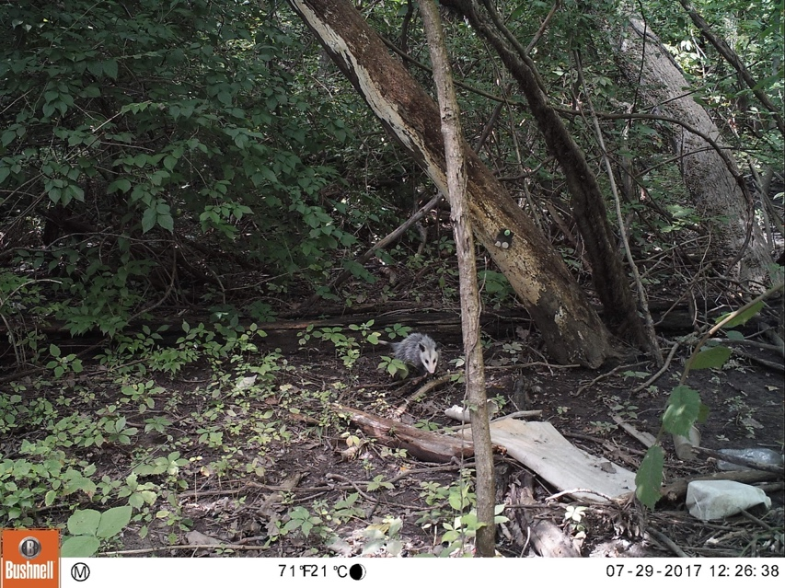
What can we do with this information?
Understand how animals use urban green spaces
Seasonal changes affecting wildlife activity
Understanding how humans impact wildlife activity
Predict occupancy of animals at sites using different environmental variables
Distance to city center
Habitat complexity
Notes:
Evynn

Slide 16
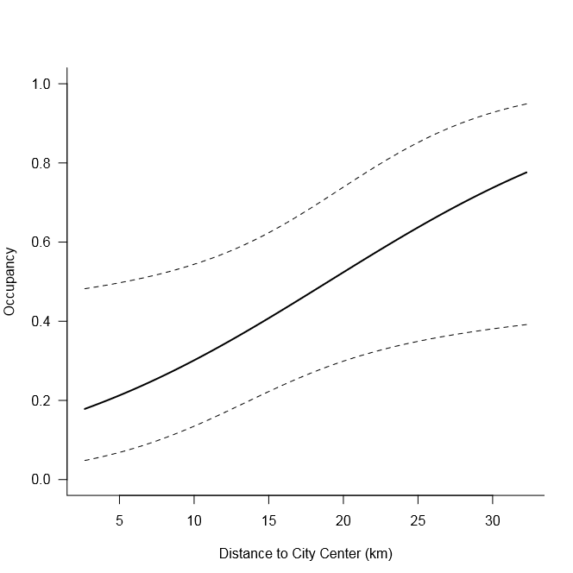
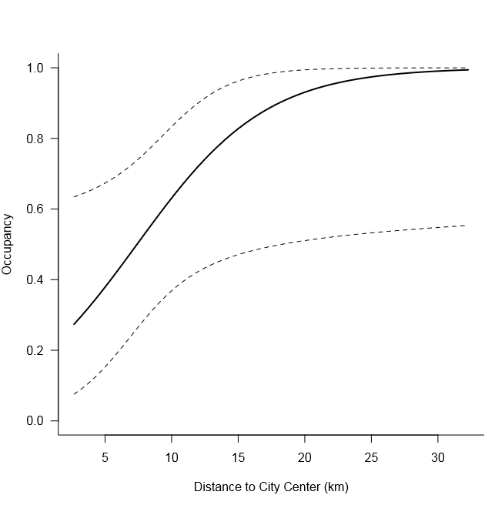
Results: Distance from city center
Deer
Rabbit
Notes:
Detection probability, probability that a species occupying that site of seeing both animals increases as distance from city center increases
We can use occupancy to predict what species are more likely to inhabit at a certain distance
Rabbits may be more sensitive to distance since they dont spike up
Looking at more species in the future
Explain probability and other axis

Slide 17
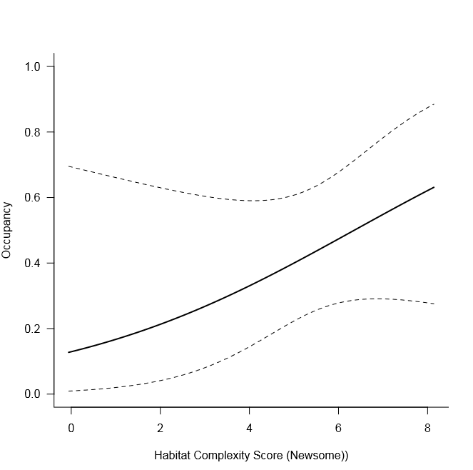
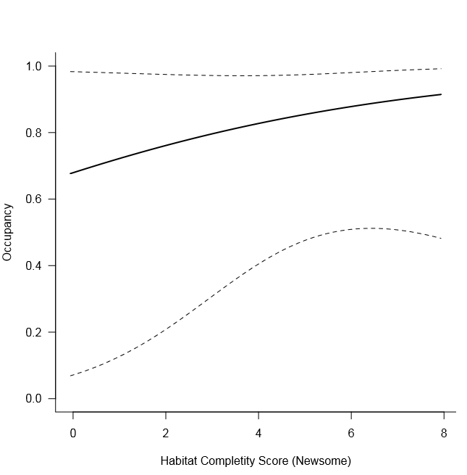
Results: Newsome Complexity Score
Deer
Rabbit
Notes:
Detection probability of seeing each species increases as complexity increases; confidence intervals are larger on left side of graphs because fewer locations with habitat complexity scores of <2
NCS=canopy cover, schrub cover, herb cover, logs, rocks, debris cover

Slide 18
Future Directions Future Implications
More sites to sample
Data samples from different seasons
Change with growth of cities
Management/urban planning
Public education
Notes:
Evynn

Slide 19
Acknowledgements
Dr. Angstmann
Dr. Ryan
Dr. Salsbury
Dr. Frederick Hendricks
Indiana Academy of Sciences
Alexi Zaniker
Jacob Reeves
Natalie Pegg

Slide 20
Citations
Rodgers, A.R., Hutchinson, C., & Simpson, M.S. (2008). Methods for Sampling Small Mammals and their Habitats in Boreal Mixedwoods. CNFER Technical Report TR-001.

